Slide 1
Wenhao Wu
12/06/2012

Slide 2
About myself
Education and Certification

Slide 3
Education
Master of Science in Mechanical Engineering
Major: Thermofluid
Northeastern University
Master of Business Administration
Major: Project Management
City University
Global Supply Chain Management certificate
University of Washington
Green Belt Six Sigma
C Programming Language
HTML, CSS, Javascript, JQuery, Node.js

Slide 4
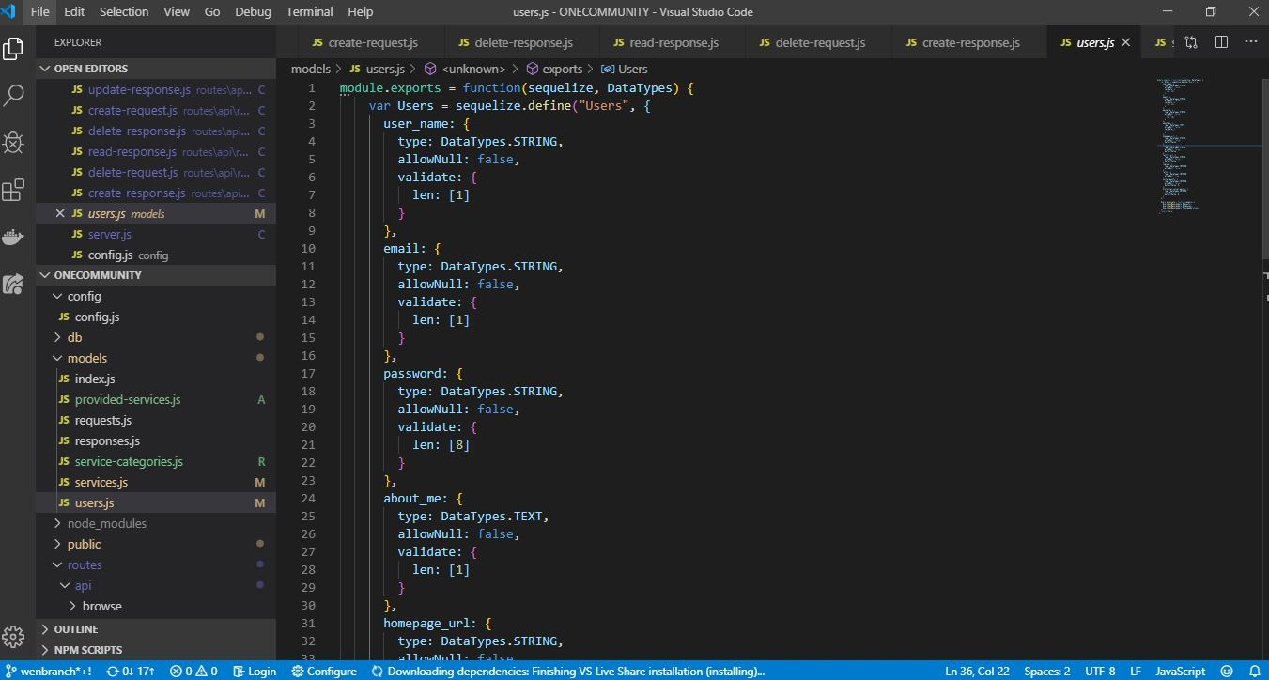
Coding BootCamp

Slide 5
About myself
Achievements

Slide 6
Patent and Publication
Patents - as co-inventor
United States Patent 6,113,114/824399
Issued September 5, 2000
United States Patent 5,971,407
Issued October 26, 1999
United States Patent 5,967,542
Issued October 19, 1999
Research Publication
The Journal of Heat Transfer – August 1992

Slide 7
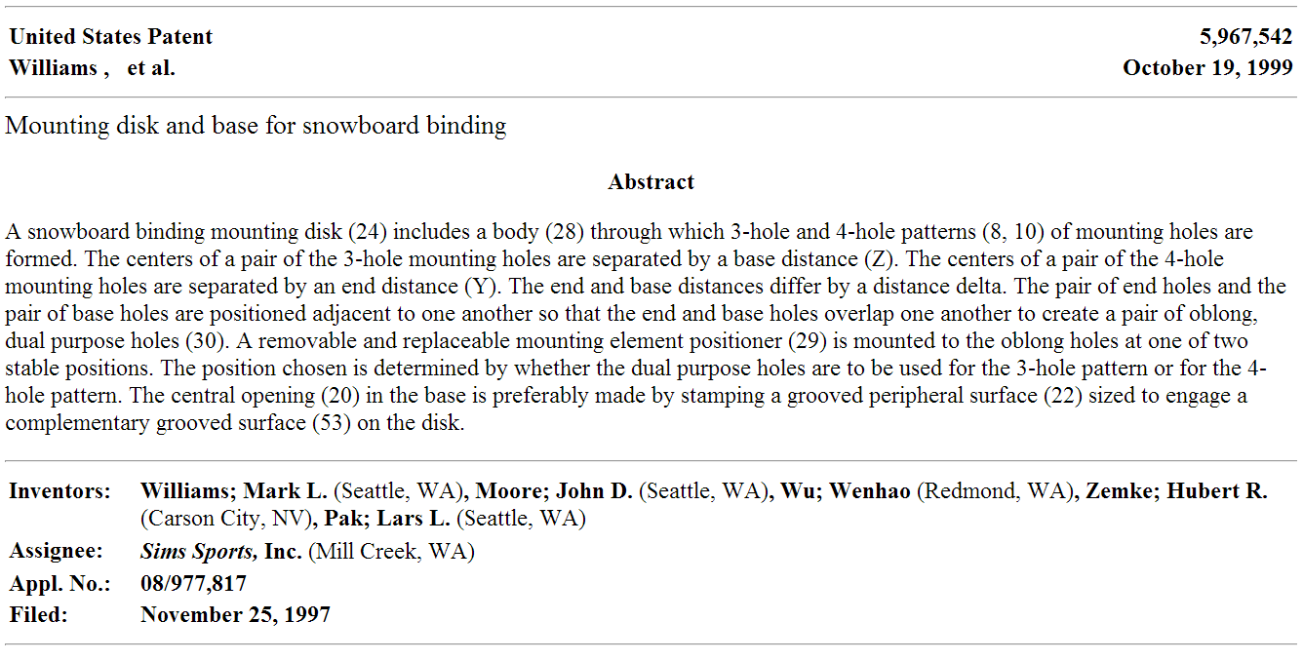
Patent Snapshot

Slide 8

Publication Snapshot

Slide 9
About myself
Experiences

Slide 10
My career path
Product Development
Automobile
Consumer
Manufacturing/Operation
Computing server
Supply Chain
Operation
NPI
Cost Model
Aerospace
Computer
Medical
Sports goods
TV
Snowboard binding
Lab equipment
Router
MEMS
Quality
LEAN
Speedometer/Tachometer
Fire suppression
Logistic

Slide 11
Engineering Experiences
New product development
Aerospace
Honeywell MEMS product
Automobile instrument
EQUUS
Consumer
Microsoft, Panasonics
Router
Cisco
Medical lab equipment
Micronics
Sports equipment
Sims Sports
Industry Computer and Access Point device
Watchguard (802.11a,b,g, and n)
Notes:
The reason I mention my extensive engineering experiences is I was in the same position to any of engineers and understand every challenge engineer facing and I can always offer out of box thinking

Slide 12
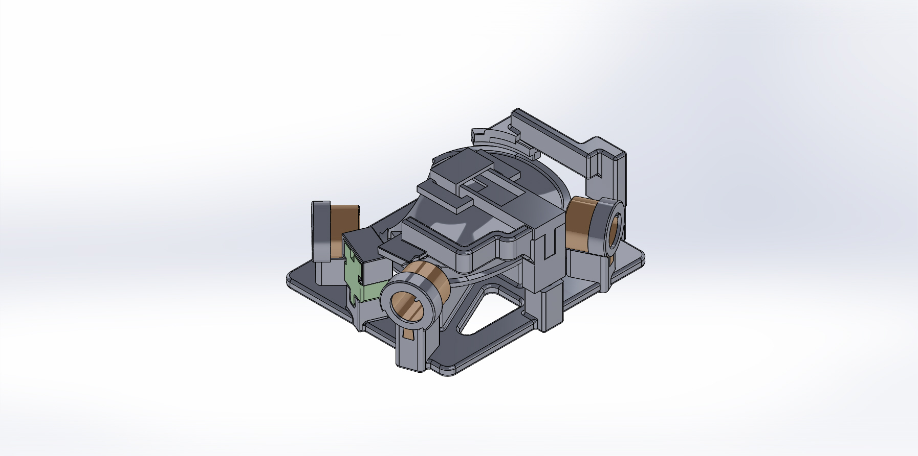
Example of CAD work

Slide 13
NPI Program management
Manage program from inception to production
Cost and contract negotiation
Vendor selection and qualification
Vendor early involvement
Resolve conflict
Notes:
I do not like conflict so I always find a way to resolve it
An example, WG software engineer blame it is hardware problem that they cannot achieve performance. I went talk to vendor if they can help and found Intel has solution build into their driver and our engineer did not know that. I got the document from our vendor and provide it to engineer. Problem solved
Another example, customer complain WG product fried during thunderstorm and blame our product did not meet safety standard. I went through design spec and we meet UL 60950-1 and the product was design to withstand 2k voltage. I had contract manufacturer test the product and it only failed after 5k voltage. I stop company for unnecessary RMA and prove it is customer’s responsibility to have their facility thunderstorm proof.

Slide 14
Product Development Cycle
Business Development
Concept
Ideation
Product Development
Preliminary Design
Product Engineering
Production
Production Ramp up
Production Sustaining
EOL
End production line
Roadmap development
Product Research
Design Validation
Production Readiness

Slide 15
DFX

Slide 16
DFX
Design for Manufacturability
Design for Assembly
Design for Cost
Design for Usability
Design for Sustainability
Design for Upgradable/Scalable
Design for operation
SKU/Hardwar model/Software version
Forward thinking
Notes:
Early manufacturer involvement is very essential to achieve successful project this can literally drive all DFX activity, using Microsoft Zune and Apple iPod as example

Slide 17
DFX for Software
Bug fixing
Firmware upgrade
Software Upgrade
Software version turns on by License key for easy production process
Notes:
Different software features determine the SKU or even hardware configuration. Software annual license fee is guarantee revenue/cash flow for company. Provide software upgrade is part of license agreement. Therefore, how to support software upgradability is essential to the product development.

Slide 18
DFX for Hardware
Hardware platform selection base on technology
Processor
Encryption chip
Type of memory
NAND
NOR
EEPROM
Size of memory
Compliance
UL, CE, FCC, VCCI, KCC,NOM,CCC
FCC
RoHS, REACH, Carbon Footprint
MTBF
Warrantee
Notes:
Carbon footprint is the newest EU requirement

Slide 19
Design for Production
Hardware configuration
Software version
Different version for different customer
Consumer
Enterprise
SKU management
Notes:
All software and hardware configuration dictate how manufacturing define production process flow. Each production order has setup fee and quality control cost associate with it.

Slide 20
Sample Program Schedule
Notes:
Sample of cross function integration of product development schedule

Slide 21
About myself
Strengths

Slide 22
Strengths
Bilingual
I have proved my bilingual ability through my working experiences is very effective between Western and Asian engineering team member. I am always able to communicate precisely and remove any language gap between two cultures. For new product that needs to be move from development into production in the shorter time frame, my bilingual ability demonstrates most efficiency.
OEM/ODM experiences
As engineer with bilingual culture background, I am always involved in managing and communicating with Asia OEM/ODM from product development to production and create win-win situation.
MBA
With my MBA degree and years of business practice, I have proven I can bridge communication between business and engineering people to align engineering activity with company goal
Notes:
Cost to certify product often been seen as unnecessary cost from business people, 40K/model for safety and EMC worldwide 250K/model for wireless but it is license for importation

Slide 23
Strengths – Cont’
Hand on operation/supply chain
Negotiate contract (terms and condition), cost, quality, manufacturing agreement, and warrantee.
Managing logistics process to ensure adequate inventory
Engineer with broad engineering knowledge
More than 20 years product design, development, and manufacture experiences with thorough understanding of DFX
Managing integration of hardware, software, manufacturing
Managerial experiences
Managing group consist of engineers, buyer/planner, and quality

